Slide 1
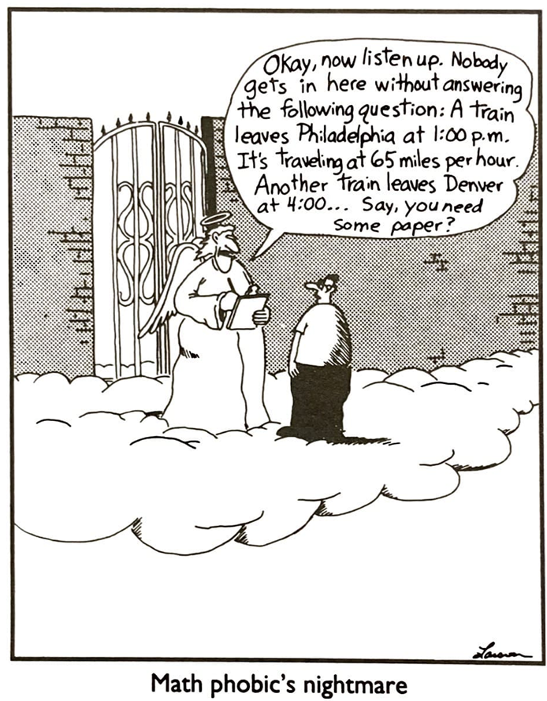
Advanced Mechanics
(Lecture 12)
ANNOUNCE / BUSINESS
HW 5 (due on this Thursday)
HW 6 posted (start early)
New topics
Concentrated loads
Stress concentrations

Slide 2
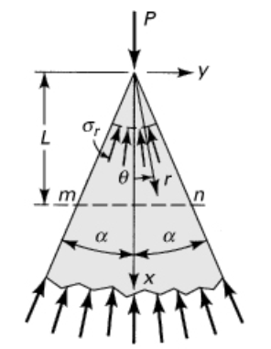
Concentrated Loads
Compression of a wedge (semi-infinite, note a cone; 2-D)
Applications?
log-splitter; knife; threads
Notes:
Applications: log splitter, threads on a screw / bolt, … (similar to hardness test, except that is conical)

Slide 3
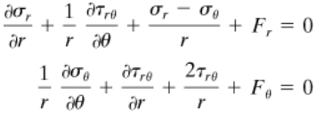
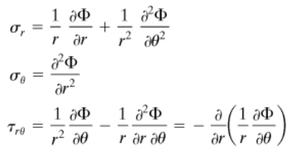
Polar Coordinates
We encounter a number of 2D problems that are best described using polar coordinates (convert equations …)
Equations of equilibrium
Airy’s stress functions

Slide 4





Concentrated Loads
Compression of a (semi-infinite) wedge
Stress function:
Stress expressions (from Airy):
Boundary conditions:
Solution:
Local plasticity for true point, so not valid at point of contact

Slide 5
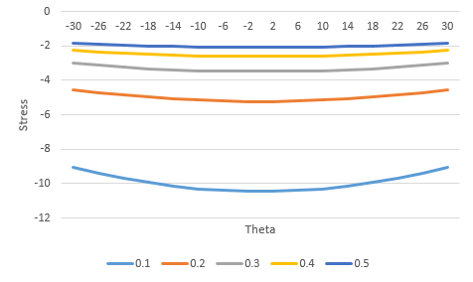
Concentrated Loads
Compression of a (semi-infinite) wedge
$σ_{r}\left(θ\right)$ for various $r$
(radii)

Slide 6

Concentrated Loads
Distribution over section m-n
Stress transformation gives

Slide 7
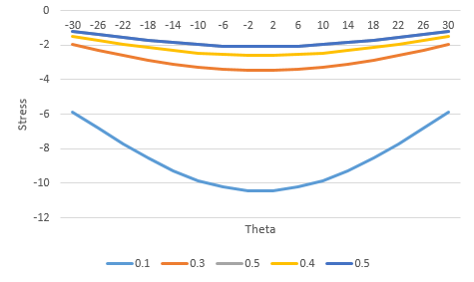
Concentrated Loads
Distribution over section m-n ($σ_{x}\left(θ\right)$ for various $L$)
Note that stresses increase as L decreases
$$σ_{x}=−\frac{P}{A}=−\frac{P}{2Ltanα}$$
Stress max at center and min on outside
Note that elementary (mechanics of materials) approach can only provide an average stress:

Slide 8
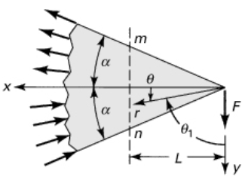

Concentrated Loads
Bending of a (semi-infinite) wedge
Stress function:
Solution:
Notes:
Applications: pencil lead, gear tooth, screw thread, …

Slide 9
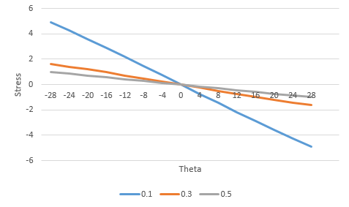
Concentrated Loads
Captures expected tension and compression with change in sign. Plot of $σ_{r}\left(θ\right)$ for various $r$:

Slide 10






Concentrated Loads
Bending of a (semi-infinite) wedge
Again looking at a linear section at m-n, we transform the stresses to obtain …
(max for $α=∓ 30°$)
(max for $α=∓ 60°$)
(max for $α=∓ 45°$)

Slide 11
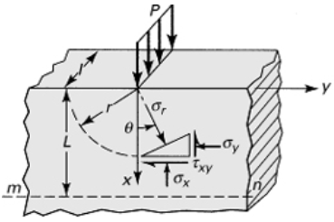

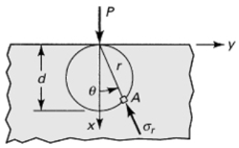

Concentrated Loads
Concentrated load on a semi-infinite plate
Using solution for compression of wedge with $α=π/2$
Note this predicts that radial stress magnitude is constant around circle of diameter d

Slide 12
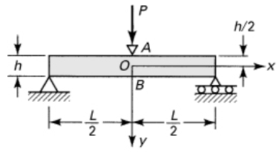



Concentrated Loads
Concentrated load on a beam
The concentrated load creates local stresses in addition to those predicted by the familiar flexure equation
Resultant forces:
horiz:
vert:
Notes:
Consider stress state of point just to the right of point P, with some slight x-depth into the beam:
- compression in y direction due to overall bending
- convert radial stress due to point loading to x and y and sum to overall bending stresses -> exacerbates compressive stress

Slide 13
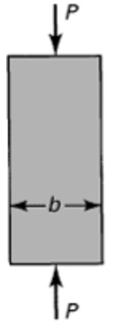
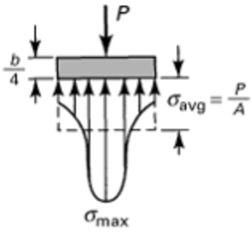
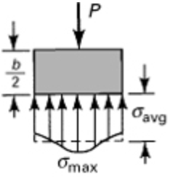
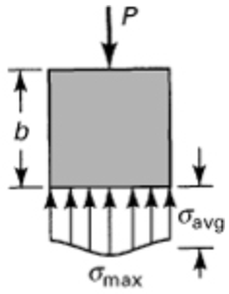
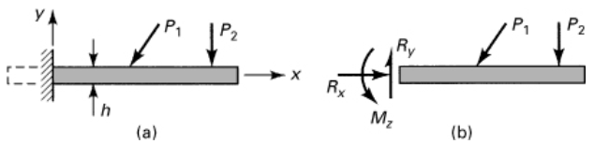
Saint Venant’s Principle
This principle is the basis for replacing any cut section with a simple moment and two forces (in 2D)

Slide 14
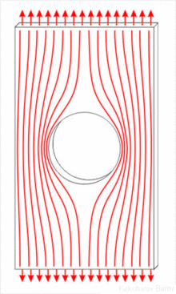
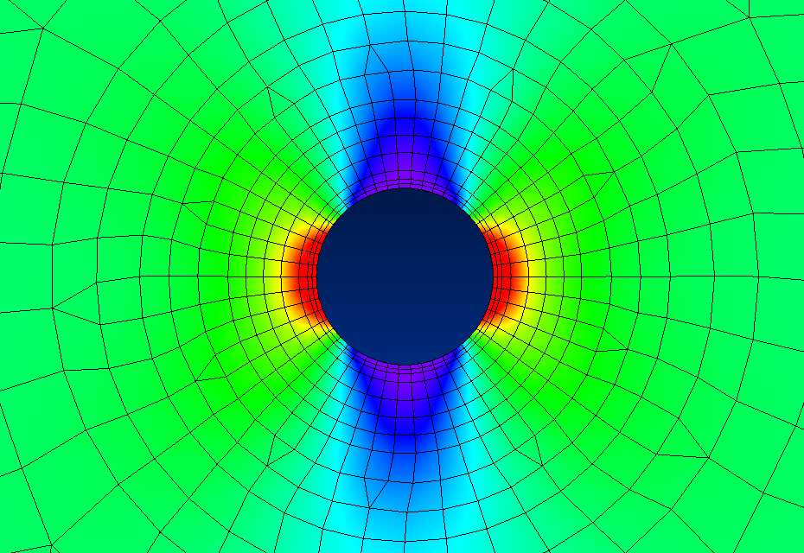

Stress Concentrations
Stress magnified at abrupt changes in cross section, such as holes, notches, and fillets
Some cases can be analyzed using linear elasticity, but usually rely on experimental techniques, like photoelasticity
Common sites of crack nucleation … most fractures in machine elements begin at stress concentration sites
Use stress concentration factor K to characterize severity of concentration
(Wikipedia)
(https://www.fracturemechanics.org/hole.html)

Slide 15
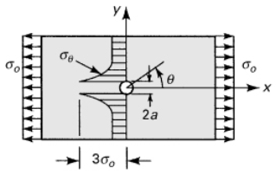
Stress Concentration
nominal stress?
Notes on nominal stress
Value of stress if stress concentration was not present
Typically use reduced cross section for calculation (check reference used); often different from “far-field” stress
Equation valid as long as max stress does not exceed yield. For ductile materials, the stress concentration is insignificant where max stress exceeds yield in static loading, but it can’t be ignored in dynamic or thermal loading.

Slide 16




Circular Hole:
large plate, simple tension
Airy’s stress functions:
(“large” means width >> $a$)
$$K=3$$
Notes:
Note that these same equations in the 6th edition have a number of sign errors. These are correct.

Slide 17
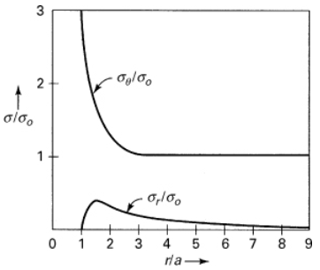
Circular Hole: large plate, simple tension
Graph of tangential and radial stresses for $θ=π/2$ versus the distance from the center of the hole
at r = 9a, σ_{θ} ≈ 1.006σ_{o} and σ_{r} ≈ 0.018σ_{o}
Notes:
Why is sig_r in tension here?

Slide 18
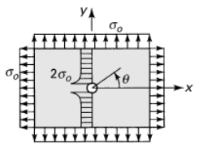
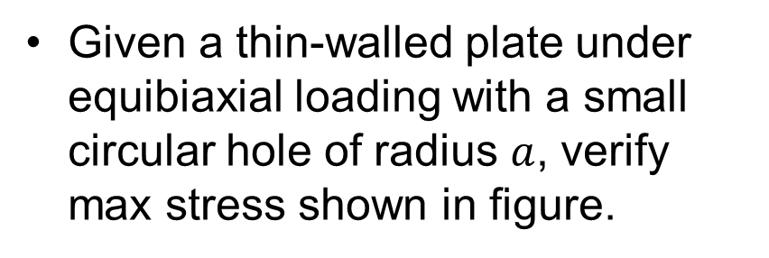


Example: circular hole, biaxial tension
Given a thin-walled plate under equibiaxial loading with a small circular hole of radius $a$, verify max stress shown in figure.
$$=$$
$$+$$
Notes:
- Work through this as example

Slide 19
Notes:
- Work through this as example

Slide 20
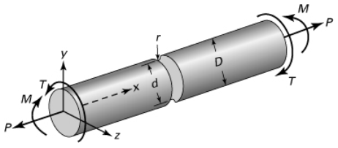
Other Shapes, Loading Modes
Example 3.4: Determine the maximum principal stress. Assume $D=11 mm$, $d=10 mm$, and $r=2 mm$.

Slide 21
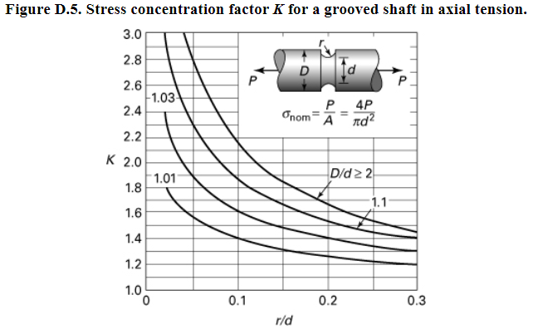


$$\frac{D}{d}=\frac{11}{10}=1.1$$
$\frac{r}{d}=\frac{2}{10}=0.$2

Slide 22
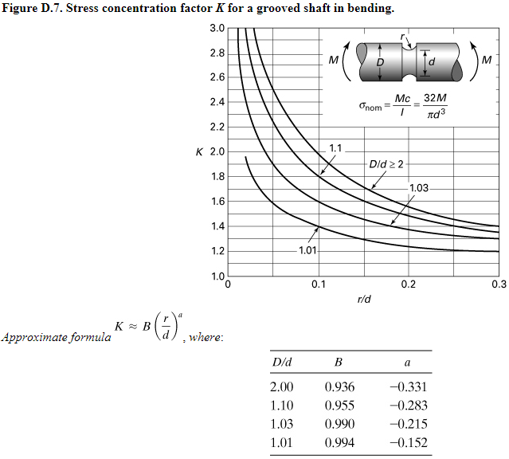

Slide 23
